Slide 1
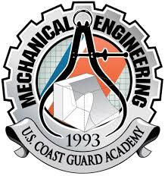

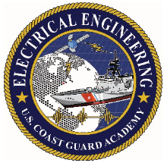
Autonomous Surface Vessel Status Presentation #2
1/c Ryan Barlow, 1/c Patrick Raymond, 1/c Connor Glynn, 1/c Samuel Kim, 1/c Wilson Moorer, 1/c Chanbopich Tann
Advisors: LT Ledzian and Dr. Reza
04 November 2021
Notes:
Connor

Slide 2
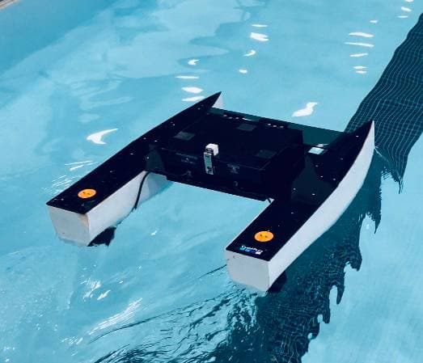
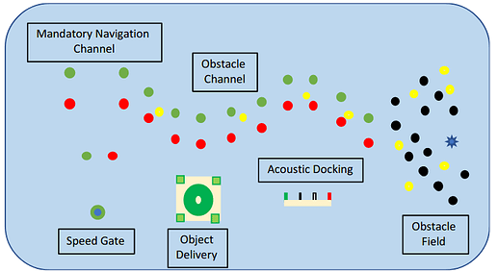
Mission
RoboBoat Competition
Navigation Channel
Obstacle Channel
Obstacle Field
Acoustic Docking
Payload Delivery (UAV)
Speed Gate
ASV:
- travels Remotely and autonomously
- fulfill Capability gaps
- Coast Guard missions
Notes:
Tann ASV : Create a vessel that can travel remotely and autonomously to avoid collisions, keep course, dock, and navigate accordingly to fulfill the capability gaps of autonomous vessels conducting Coast Guard missions.

Slide 3
Content of Updates from Status Presentation #1
Revisited Requirements and Design Approach
Budget & Costs
Conducted first test in float tank and pool
Stakeholders
Reviewed Questions from Presentation 1
Notes:
Tann

Slide 4
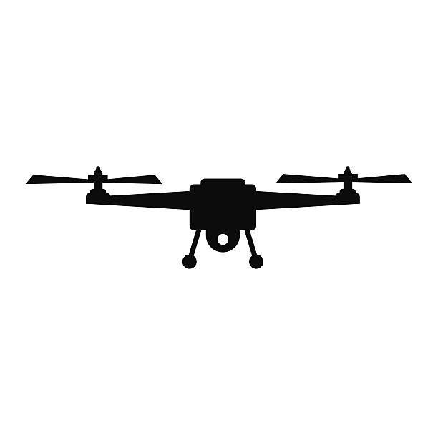
Status Presentation 1 Feedback
CG – 4 / CG – 7 Stakeholder
UAV takeoff performance with bowl
Notes:
Connor

Slide 5

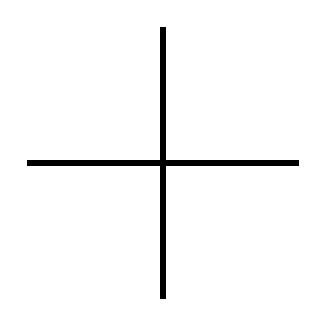

Requirements and Key Performance Parameters (KPPS)
Refined requirements document
Top 3 KPPS
1 – Steer a given course at constant speed T: ± 5 degrees, O: ±3 degrees
2 – Minimize cross track error relative to length of leg; T: 10%, O: 5%
3 – Acoustic D: T: 95%, O: 99%
Notes:
Connor

Slide 6
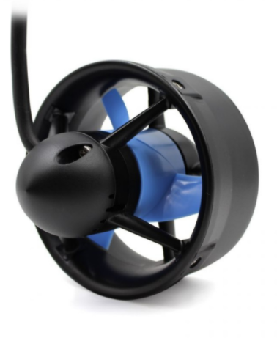
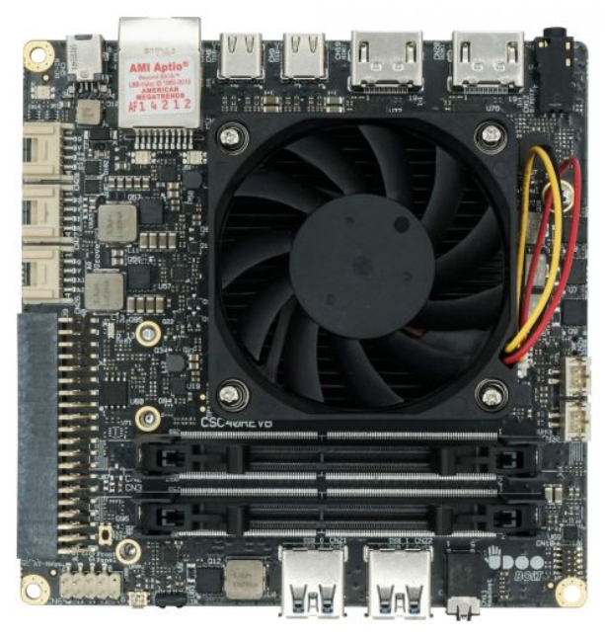
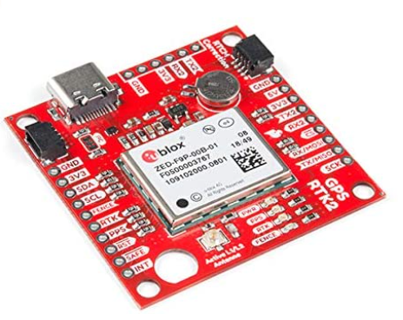
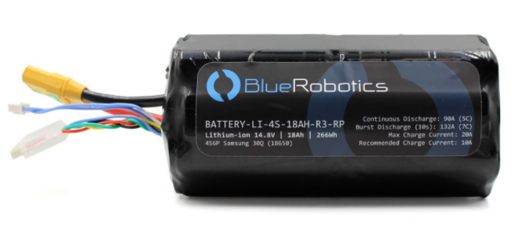
Anticipated Costs
Utilize previous materials
Major costs this year
Damaged Parts
Needed upgrades in equipment
RTK-GPS - $289
New Camera - $100
Estimated total expenses of ASV
Hull (foam)– $100
Thrusters – $200 each
Udoo Bolt - $459
Batteries - $290 each
Camera – $70
Lidar – $50
Other Electronics - $500
Planned Total Budget - $500
Notes:
Patrick

Slide 7
System Design Approach
Hull Design: Catamaran propelled with 2 differential thrusters
Computing Systems:
Arduino Leonardo (built into Udoo)
Used for IMU data
PD Controller
Udoo bolt
used for sensors and data acquisition
External computer
Used for running image processing and pathfinding algorithms with GPS data
Portable power source and separate batteries
Notes:
Wilson
Catamaran is most stable and has wider beam (allows for all electronics to be safely put onto the boat) than flat-bottom and kneeled hulls. Provides more maneuverability for the thruster

Slide 8
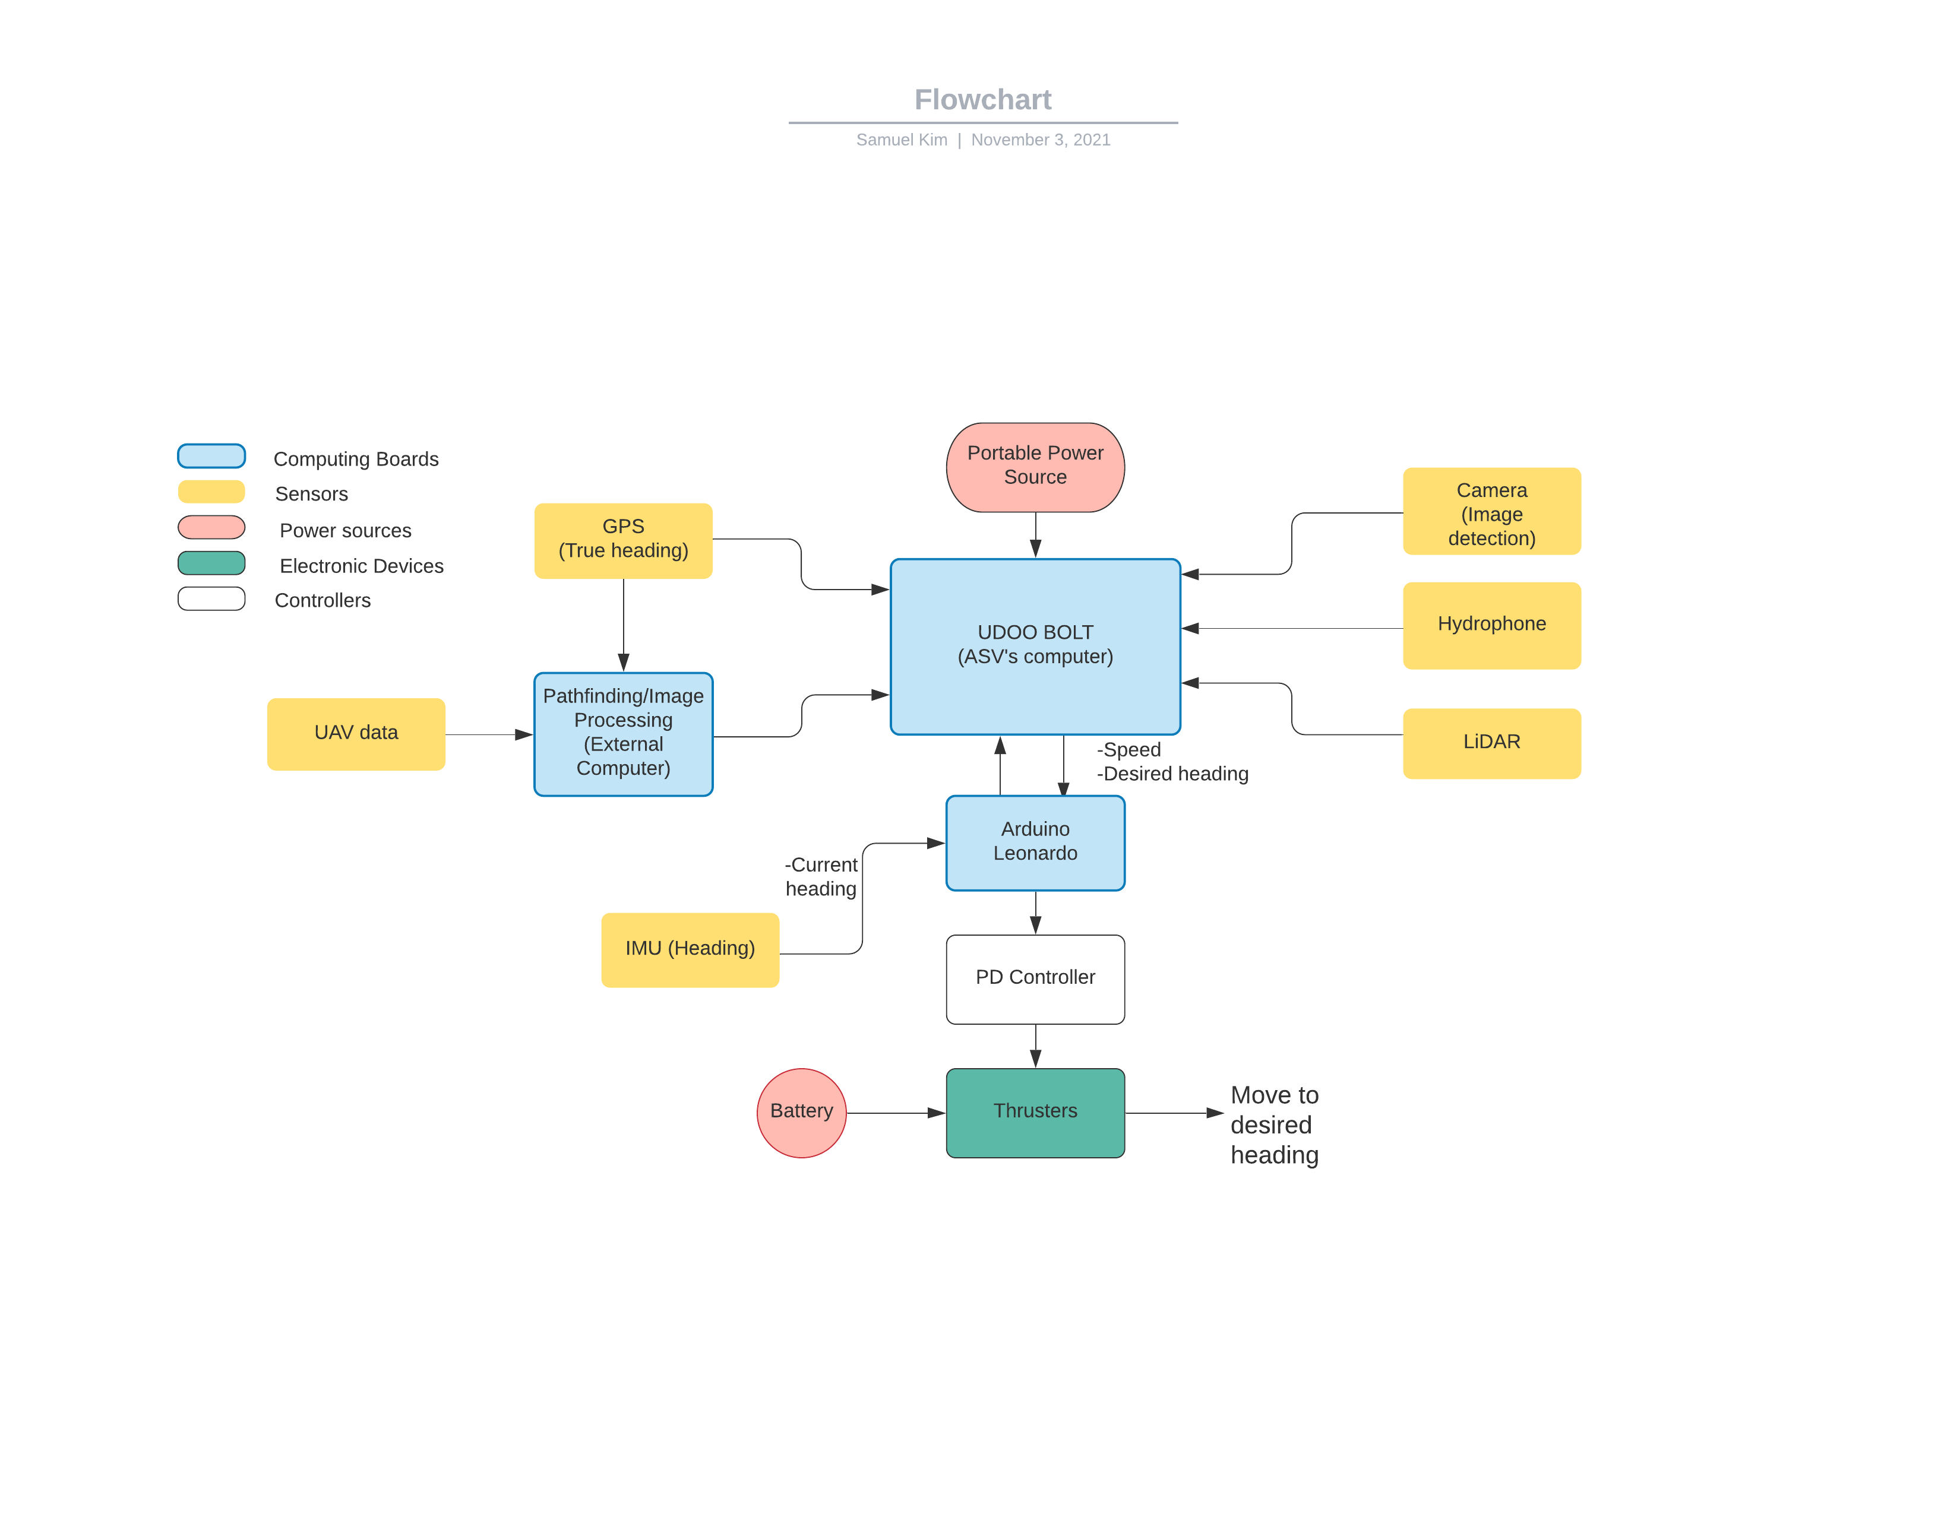
System Design Block Diagram
Notes:
Sam

Slide 9
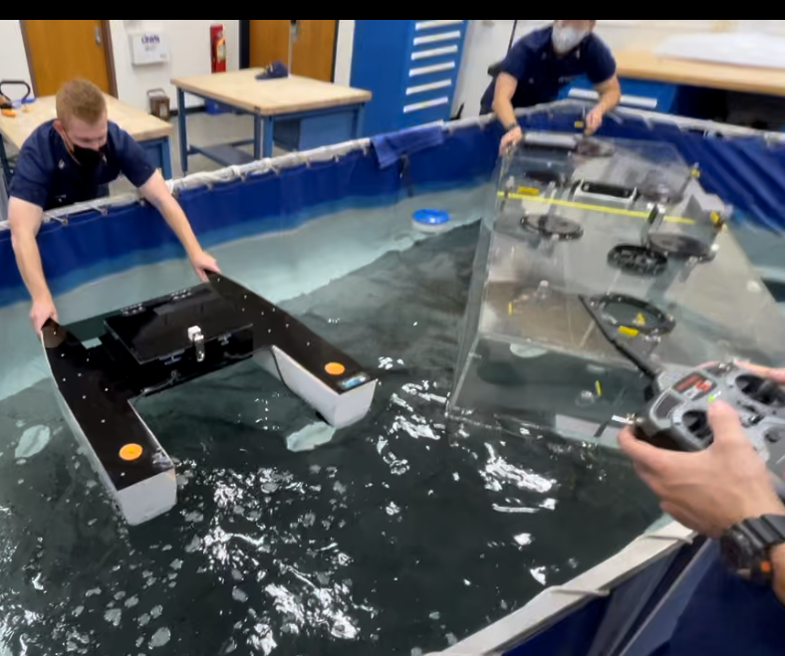
Float Tank Test Results
Utilized float tank in the NavArch lab:
Waterproofing
Emphasis on safety
ASV under remote control:
Thruster output – reliability
Forward/Astern performance
Turning capability
Outcome from testing:
Favorable: vessel stability and thruster performance
Unexpected positive – thrusters much stronger and more reactive
Notes:
Ryan
Utilized float tank in the NavArch lab to test ASV's performance in the water with onboard electronics:
Check waterproofing of electronics box
Major emphasis on safety, ensure no unexpected electrical or mechanical performance when in the pool
ASV under remote control function to test:
Output of the thrusters – evaluating reliability
Stop/start performance – bow and stern reaction to forward and astern power
Turning capability with the thrusters (twisting, one thruster off)
What we learned from testing:
Favorable results for vessel stability and thruster output
Unexpected postive – thrusters much stronger and more reactive

Slide 10
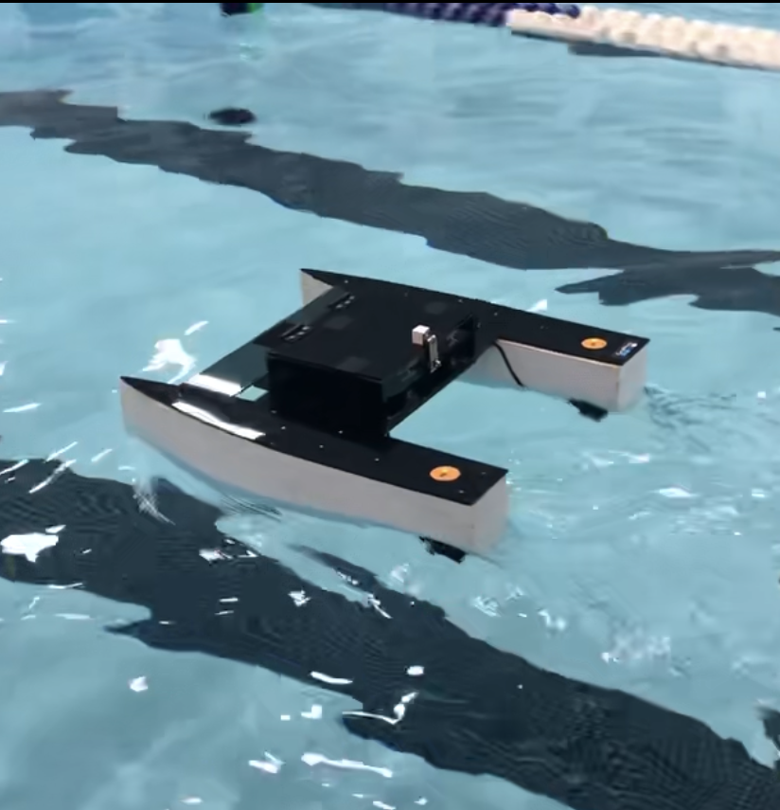
Indoor Open Water Test
User Control
Vessel Dynamics
Reliability
Safety
Environmental Protection
Notes:
Pat

Slide 11
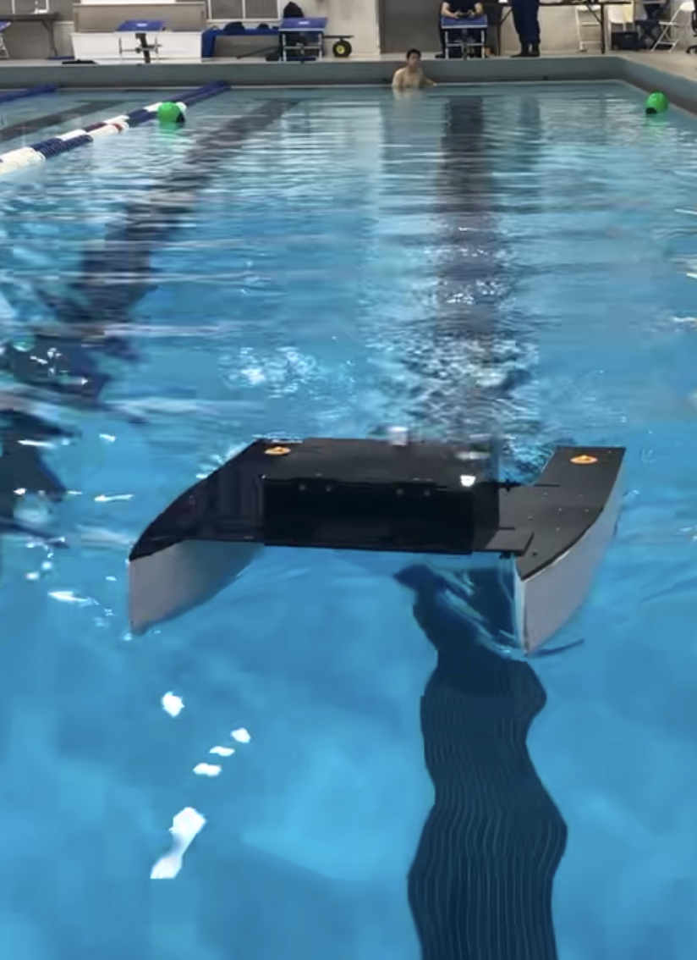
Analysis of Testing
Future use of Simulink Model
Understanding Limitations
Implementing PD Controller
Moving Forward with Testing
Notes:
Pat

Slide 12
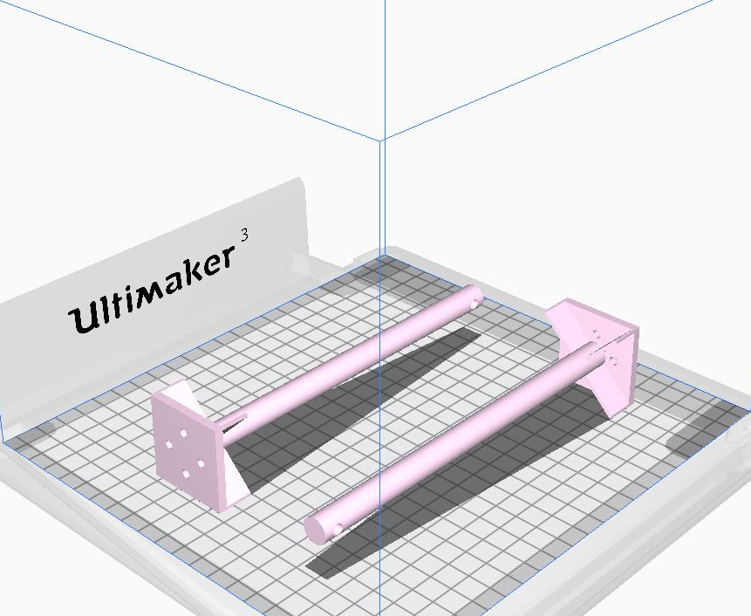
ASV Hardware Updates
Three separate thruster mount casualties
Attributed to previous 3D print method – weakness in horizontal direction
Reprinted the mounts horizontally
Potential switch to aluminum mounts
Redesigned & 3D printed LiDAR mount for better connection to servo motor – eliminate slipping
Notes:
Ryan
Three separate thruster mount casualties – all sheared off at same place on the mount
Based on stress analysis of the part, attributed to vertical 3D printing creating weakness in horizontal direction
Remedied by rotating the model on the 3D printer bed to print the mounts horizontally
Potential switch to aluminum mounts if still seeing shearing when operating at higher thrust
Redesigned and 3D printed new LiDAR mount to gain better connection to the servo motor to eliminate slipping during LiDAR operation

Slide 13
Accomplishing Requirements
Driving autonomously through competition course
Autonomy achieved through various sensors
Identifying and combining inputs
Managing schedule and costs
Proper documentation
Notes:
Wilson
We developed a design that will have the ability to compete in the roboboat competition course and demonstrate the vessels ability to close the capability gap of ASV’s conductuig coast guard missions
We utilize various sensors such as an IMU, GPS, camera, and lidar, coupled with our thrusters to achieve autonomy
Taking headings from our IMU
Utilized the hull and hardware left from last years group in order to avoid excessive budget spending and speed up the process of developing a functional and testable vessel
We keep all important documentation such as hardware user guides/specs or our requirements documentation in our teams page folder in order to maintain organization and make it easier for group members to obtain when needing previously obtained information.

Slide 14
Moving Forward
Implement the PD Controller
Integrate an IMU sensor to allow the vessel to distinguish relative heading
Sensor fusion
Allows for the ASV to correct its relative heading to true heading
Open water controller test
Test the ASV on open water in the Thames
Continue with UAV landing pad design
Implement other Sensors
Global map from UAV
Create a path for the ASV using an image from the UAV
Processed on an external computer
Coordinate with UAV team
LiDAR, Camera (image processing), Hydrophone
Notes:
Sam

Slide 15
Questions

